Slide 1
Presentation to World Meteorological Congress
External Auditor Reports
30 May 2023

Slide 2
Presentation of the reports
Audit report on FS 2022
Including the IT audits, we have issued 23 recommendations and 1 suggestion.
We have also carried out the follow-up to the previous recommendations.
Performance audit report on cybersecurity
We have assessed the current situation and the actions undertaken by Management.
We have issued 9 recommendations and 5 suggestions, aimed to improve the current framework.
All findings of the two reports were discussed with Management not only during the audit, but also through the due cross-examination. The WMO’s comments to our recommendations, approved by the Secretary-General, are included in the reports.

Slide 3
The financial audit report: main findings
Assets register and management
On this subject we have issued two recommendations, aimed to improve the assets’ register and management, especially regarding portable equipment, as well as items not owned by WMO.
Building
We further investigated the “droit de superficie” issues, especially in view of the forthcoming extraordinary maintenance costs to be borne by WMO; we recommended that all recommendations related to this issue be submitted to the Council.

Slide 4
Revenue for services
We examined another aspect related, directly or indirectly, with the building issue, focusing on the rental agreements with external parties of the spaces of the building.
We have issued 4 recommendations, touching different aspects, like, for example, the need of having a standardised template for the contracts, or to review of the current rates, linked to the market prices, for non-UN entities; possible measures should be studied to provide only a restricted access to the lessees, in order to improve general security and to avoid possible conflicts of interests.
Revenue from voluntary contributions
For this issue, we recommended harmonising the agreements for similar classes of contributions, in order to enhance transparency of funding conditions and to protect WMO’s rights and immunities. We also recommended assessing all planned costs, including direct costs, technical support and administrative support costs, to ensure that the contributions are sufficient to meet the delivery of the planned outputs.

Slide 5
Personnel
We have examined, in addition to the usual checks, the recruitment process as established by the Service Note 13/2021, to check if there is room for improvement of the current framework.
We issued 4 recommendations: first of all, we recommended updating the rules stated by the SN 13/2021, in order that they cover all aspects that were formerly regulated by the previous SN and not considered in the current version; furthermore, the rules for delegation of power and for the composition of the selection panel in the recruitment system should be clearly defined, and the transparency and effectiveness of the current recruitment framework needs to be improved in some respects; in addition, there is a need to calibrate the use of consultancies and to evaluate the need for stable personnel and sustainability of expenditure, according to strategic planning.

Slide 6
Procurement
We mainly focused on the sustainable procurement strategy, which is currently lacking.
We issued 3 recommendations and 1 suggestions aimed to improve the framework, considering the twelve Sustainable Procurement Indicators (ungm.org), which are grouped under 4 Pillars (Environmental, Social, Economic, General), and encouraging its supplier to participate in the UN Global Compact principles.
Controller
The former controller retired on 31 December 2022 and the post was not covered. We were informed that, with Service Note 10/2023 approved on 18 April 2023, the tasks of the Controller office were assigned to different units. In our opinion, the office is essential in the internal control system; therefore, we have not only considered “ongoing” the last year recommendation related to the assessment of the controller office, but we have also recommended, also in line with what stated by the JIU in its report on WMO management and administration, that the function should be restored and that the correct reporting line be established, and the second line be strengthened. Management reserved the right of further evaluation.

Slide 7
IT General Controls
We have carried out all the checks envisaged by the standards, as well as the follow-up to previous recommendations.
The evaluation of the IT Processes for Oracle E-Business Suite gave the result of “effective”.
We issued 1 recommendation, aimed to complete the access right review for all Business accounts.
IT audit on payroll process
Considering the relevance of personnel expenses (about 65% of total expenditure in 2022) and the ongoing transition to a new ERP, we audited this process in order to ensure that the governance, control and risk management processes in the payroll operations of the organization are appropriately designed and effectively functioning.
We were able to assess the design and operating effectiveness of organization control over payroll process, covering the full period from 1 January to 31 December 2022. We issued 5 recommendations, aimed to improve some procedures and processes currently in place, mainly related to implement automated controls.

Slide 8
Follow-up – Statistics
Report on FS | 2020 | 2021 | 2022
 | Issued | Issued | Issued
Recommendations | 21 | 30 | 23
Suggestions | 0 | 1 | 1
TOTALS |  | ISSUED | CLOSED
Recommendations of previous years (2020-2021) |  | 51 | 40
Suggestions of previous years (2020-2021) |  | 1 | 1
Recommendations issued by the SFAO (still pending at the beginning of our mandate) |  | 12 | 10

Slide 9
Performance audit report on cybersecurity: main findings
The purpose of this audit was to assess if the cybersecurity at WMO is managed effectively and efficiently, and if it is compliant with international framework NIST.
We audited not only the current framework, but also the action plan undertaken by the Management (the new CIO and CISO), taking into account that many needed measures have already been identified, but still need to be implemented, and that the organisation, when started its evaluation, gave itself a deadline of about three years to reach a level of full efficiency on the cybersecurity front. For this reason, it will certainly be necessary to conduct a new and more in-depth audit at the end of this period, to verify the actual improvements achieved.

Slide 10
All recommendations and suggestions were accepted by Management.
They are aimed to improve some procedures and processes, in order to prevent data loss or to increase access security, establishing also some automated controls.
Some recommendations are also directed to improve the training of the personnel, including executive and high-level management, to make them aware of the correct conduct to adopt in order not to create breaches in IT security.
There is the need to adopt a BYOD policy, to make that staff’s personal devices are compliant with the IT security measures of the Organisation.

Slide 11
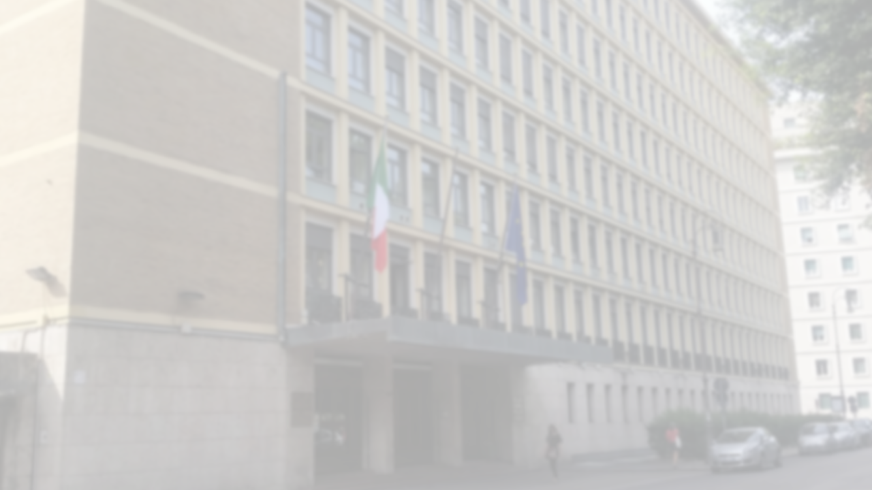
Thanks for Your Attention
Thanks for Your Attention

